Slide 1
数据结构扩展(三) -- 树状数组
307. Range Sum Query - Mutable
1649. Create Sorted Array through Instructions
你们的好朋友Eddie

Slide 2
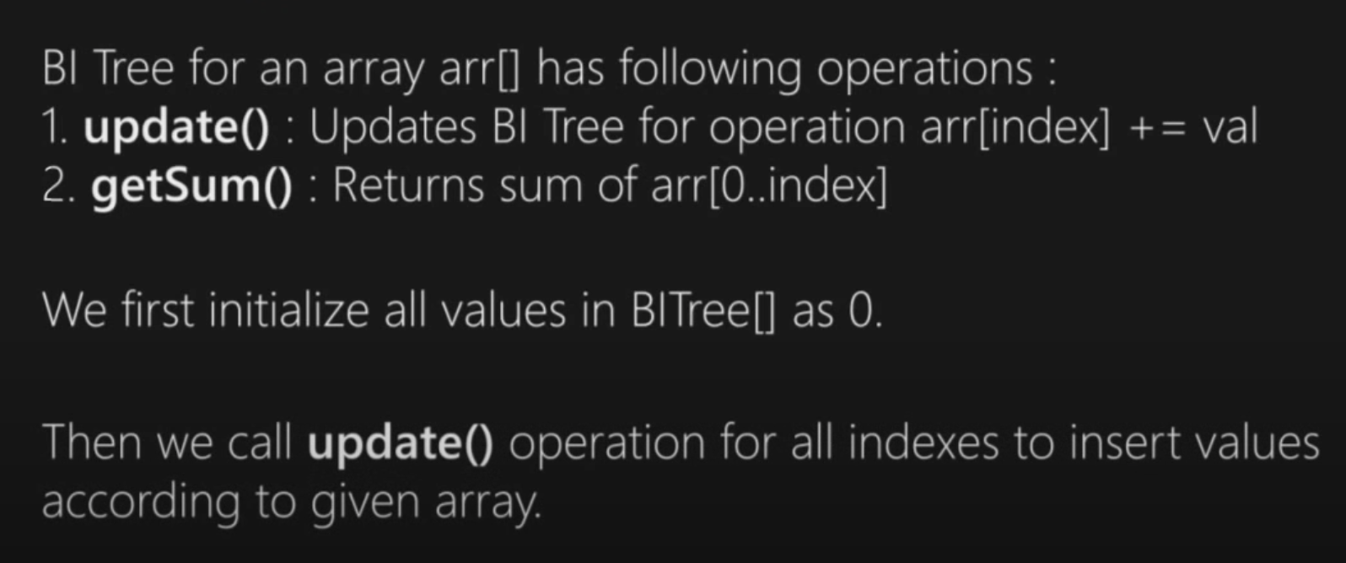
什么是BIT? 树状数组
A Fenwick tree or binary indexed tree is a data structure that can efficiently update elements and calculate prefix sums in a table of numbers.
update()和getSum()操作的时间复杂度均为O(logn)

Slide 3
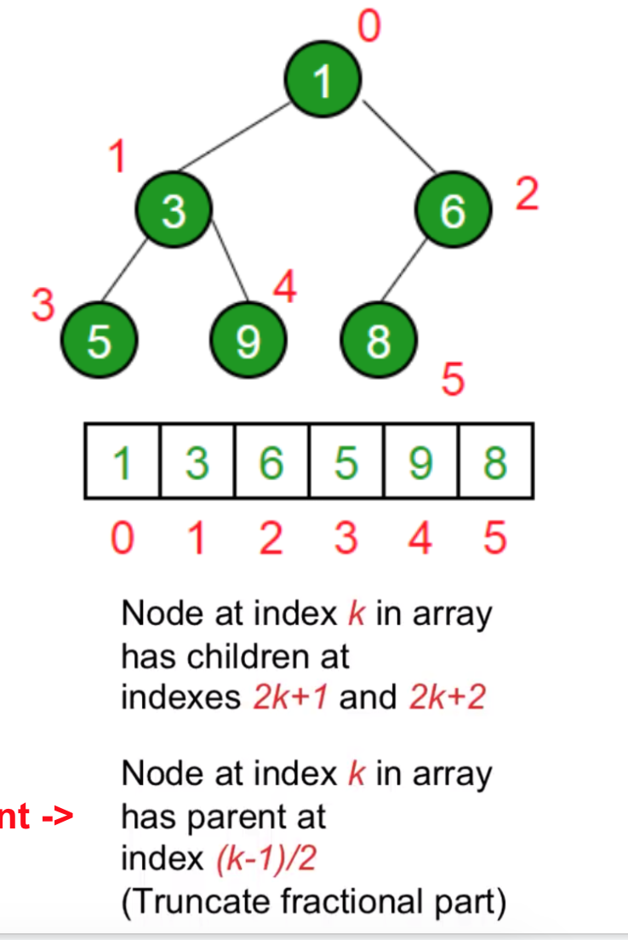
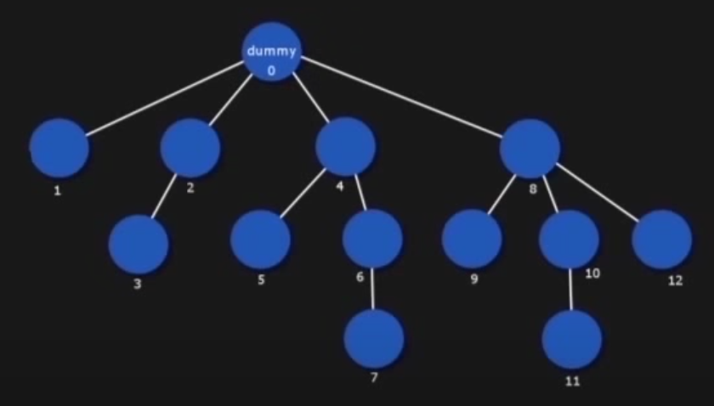
Do you still remember how heap implemented？
Now we want to do something similar, define a relation between parent node and child node so we can construct a BIT

Slide 4
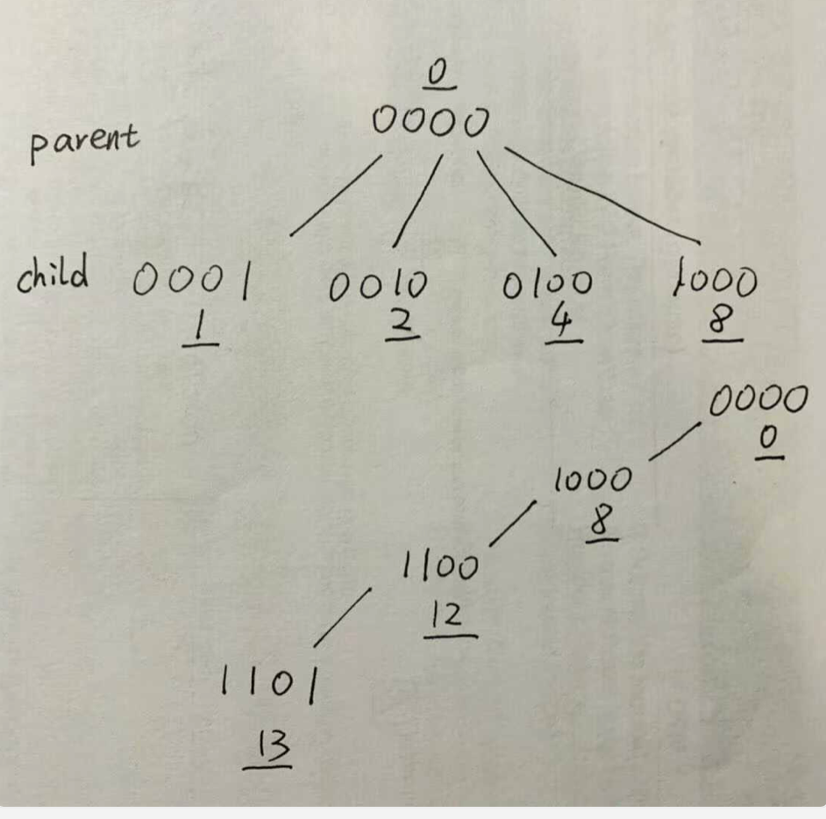
parent: -> child
add 1 in binary representation
child -> parent
remove add in binary representation

Slide 5
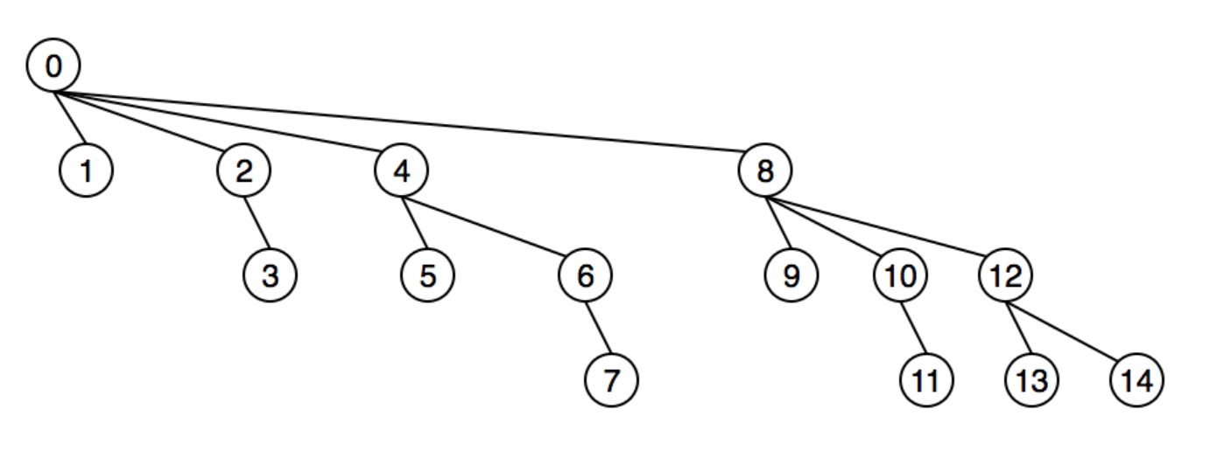
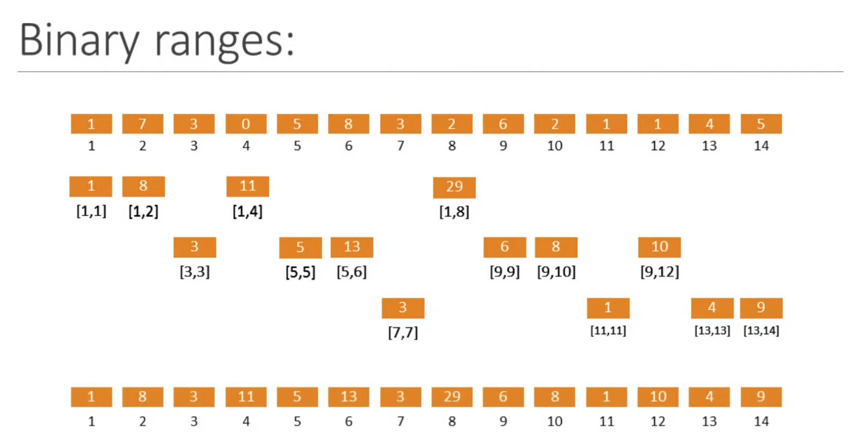

Slide 6
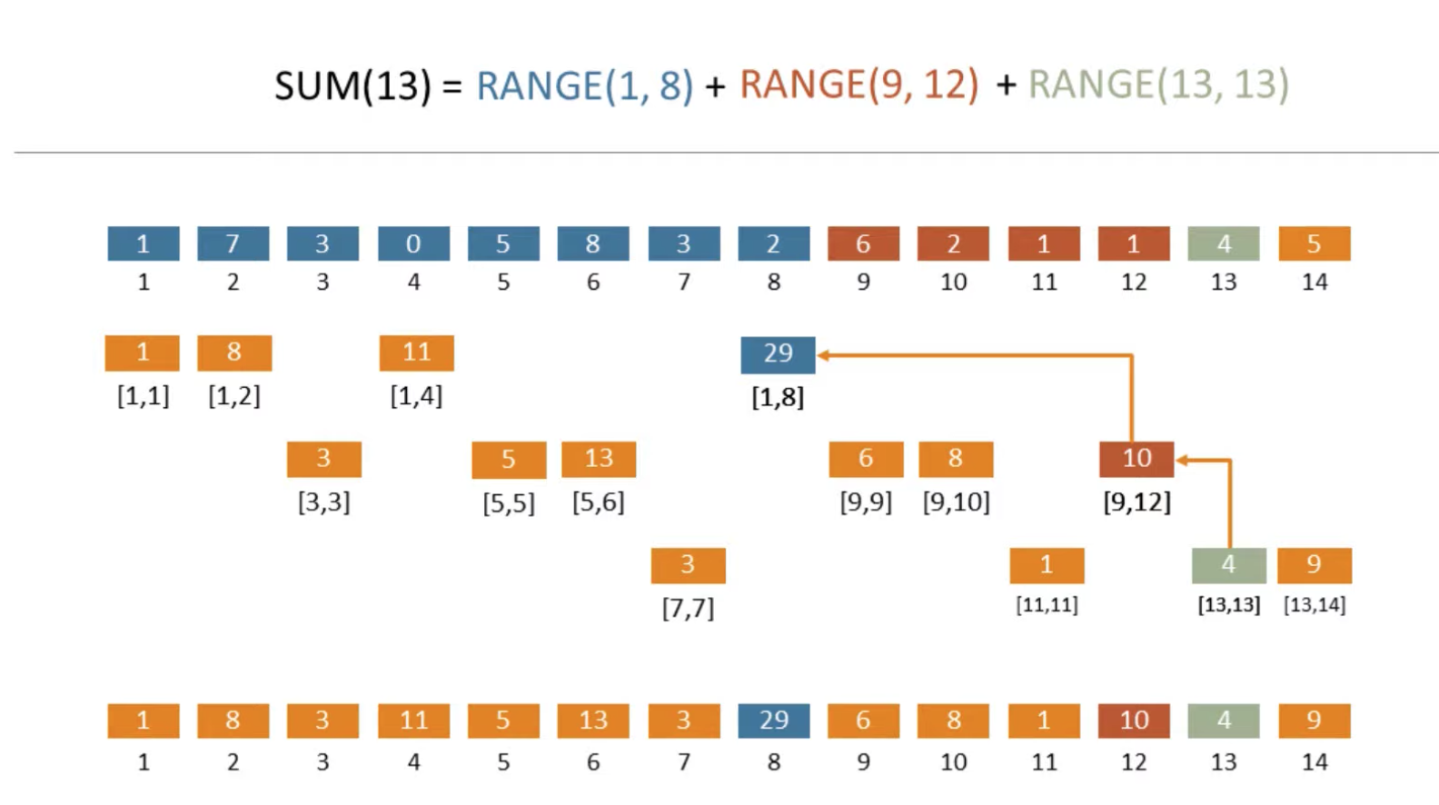

Slide 7
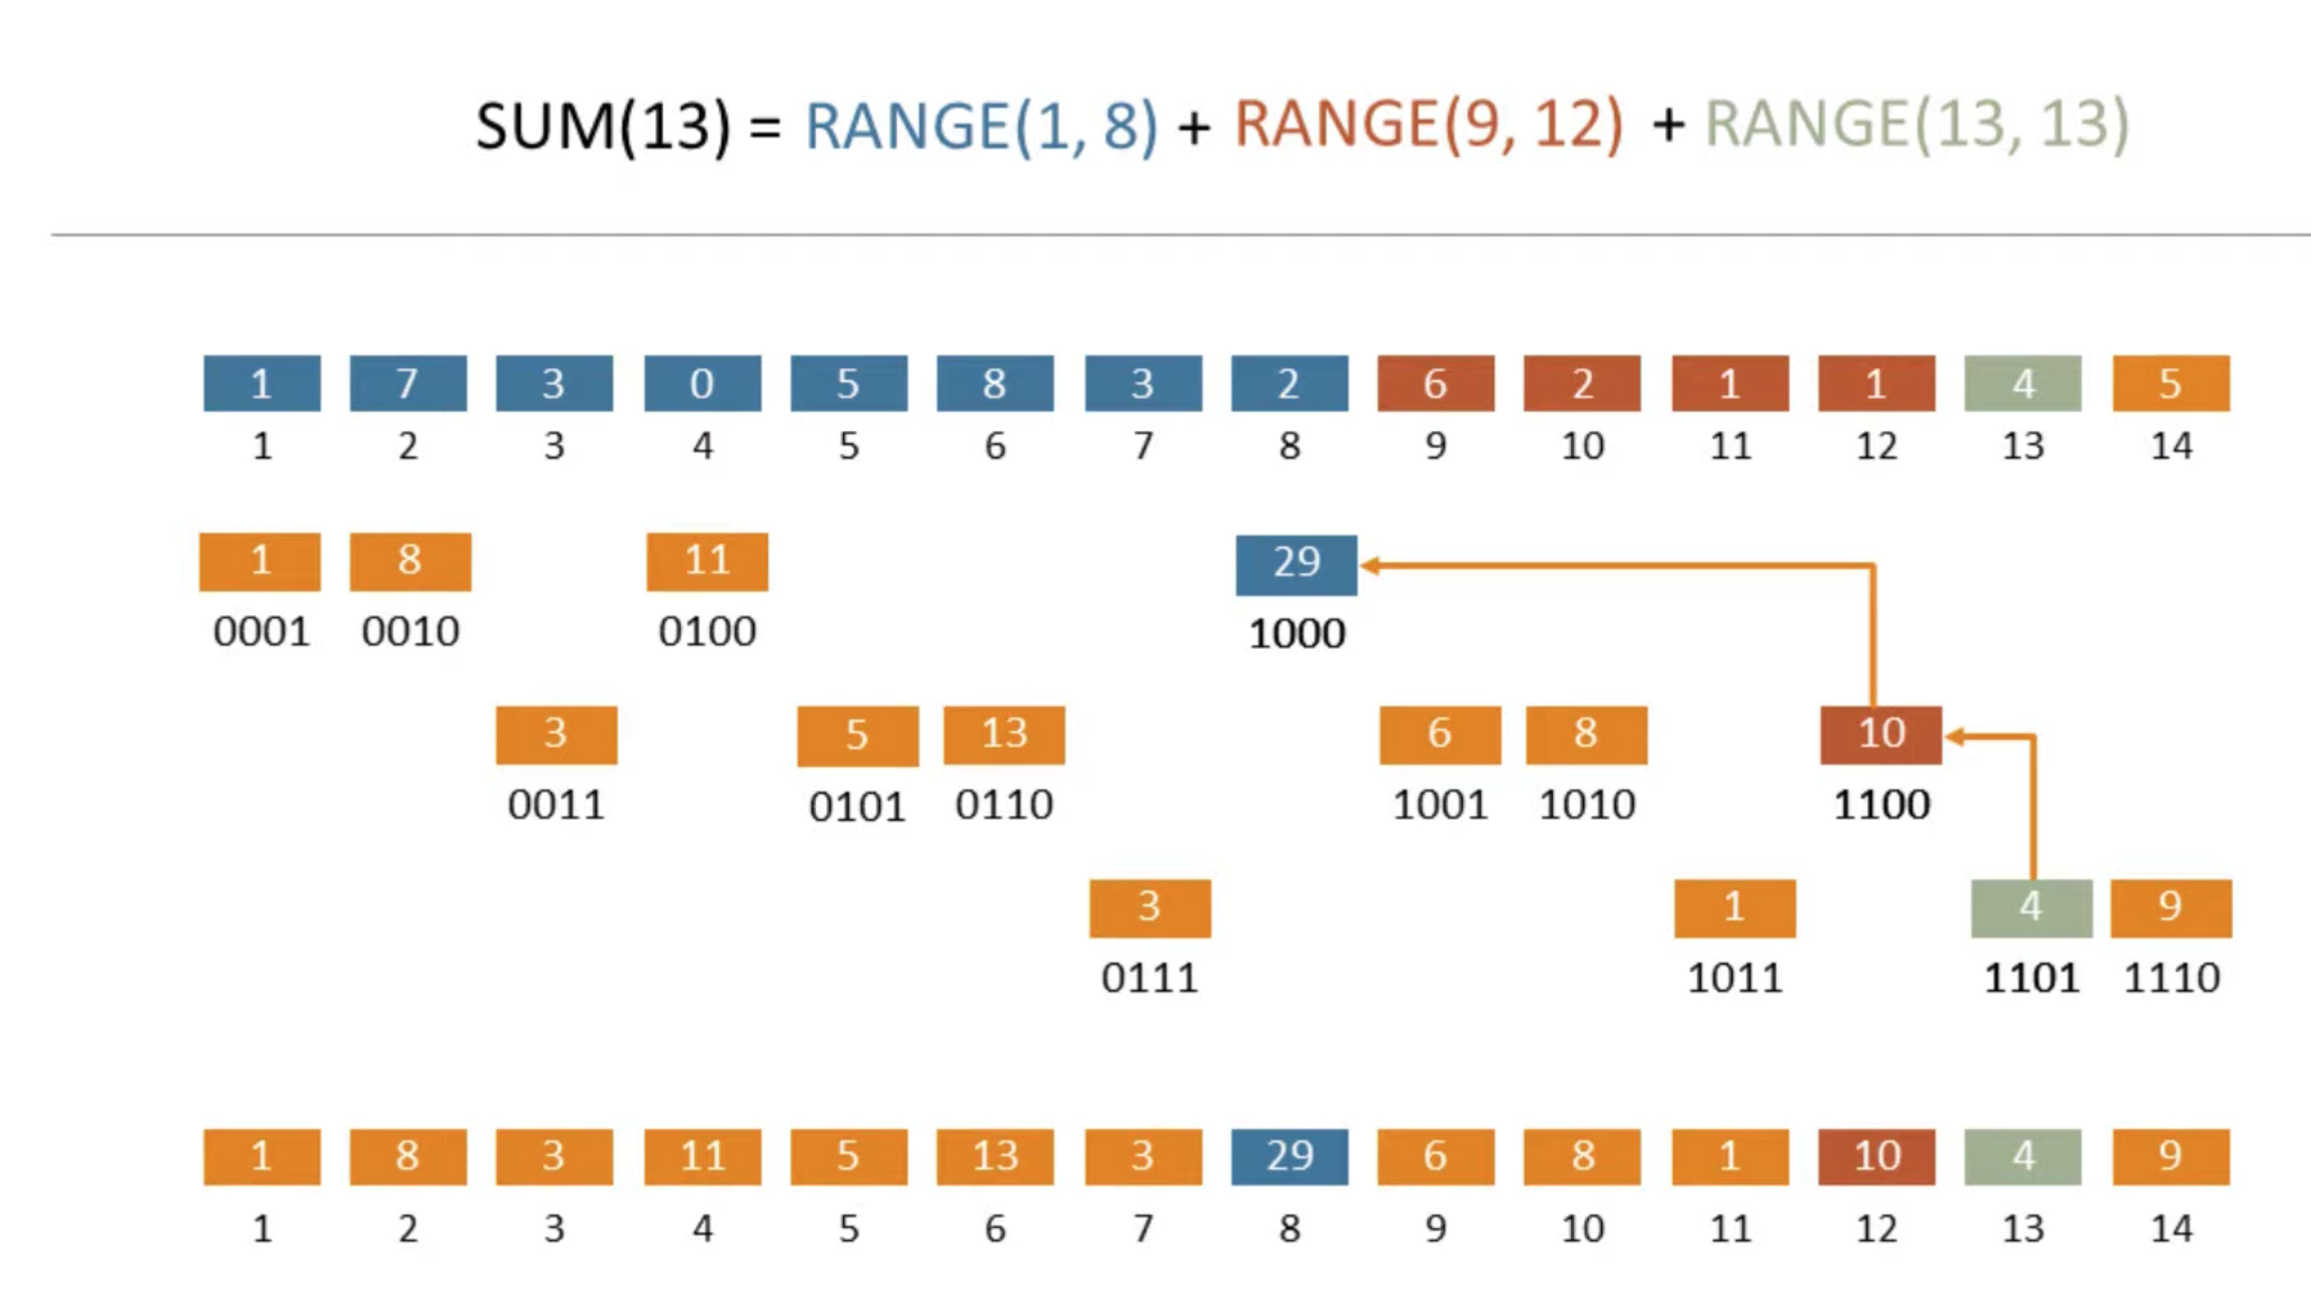

Slide 8
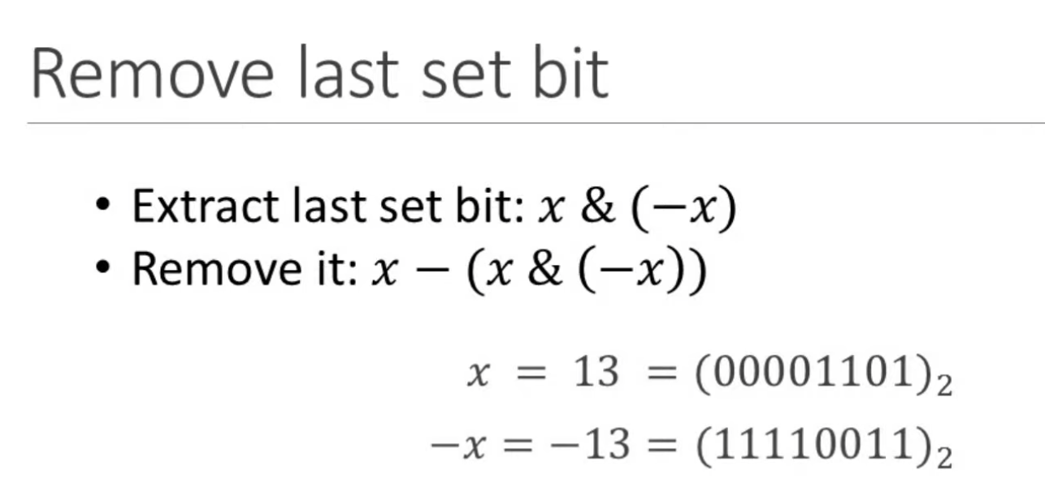
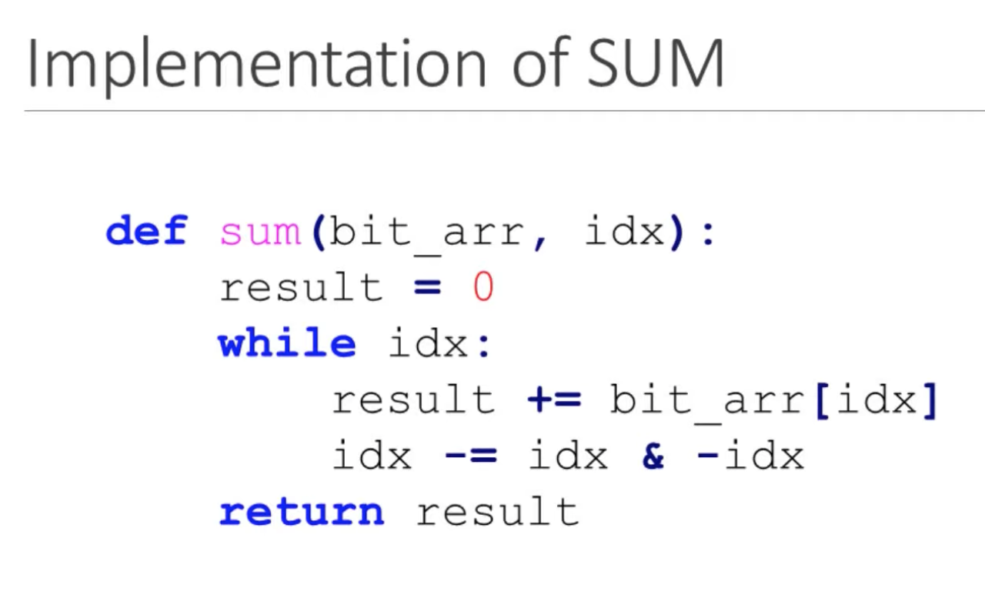
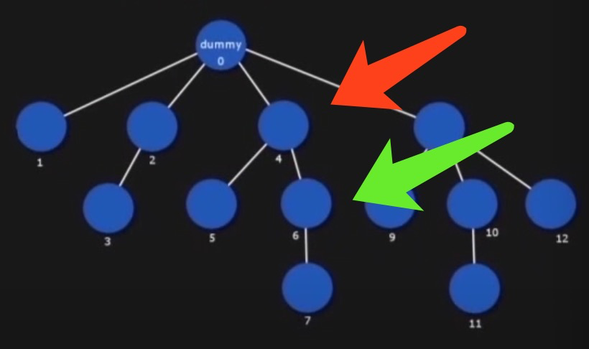
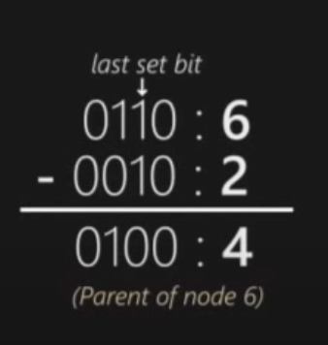
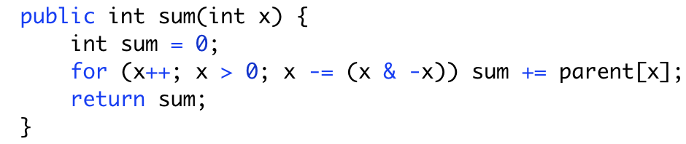

Slide 9
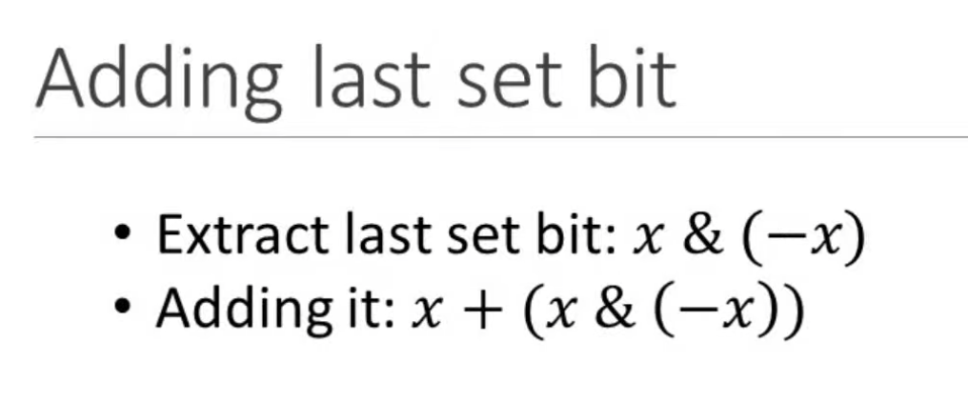
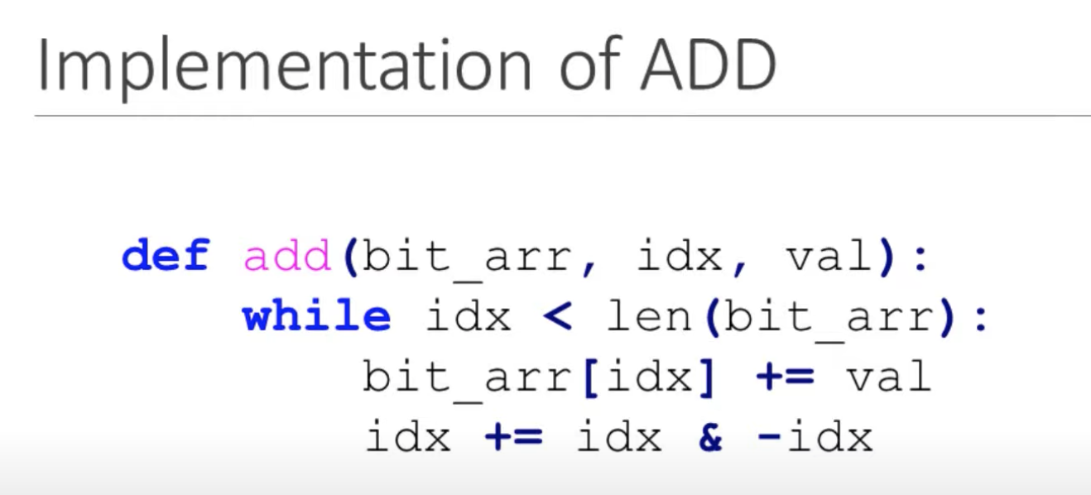
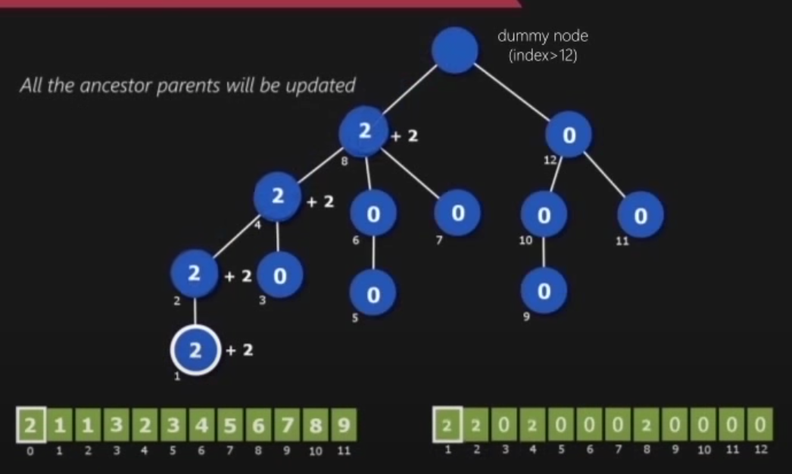
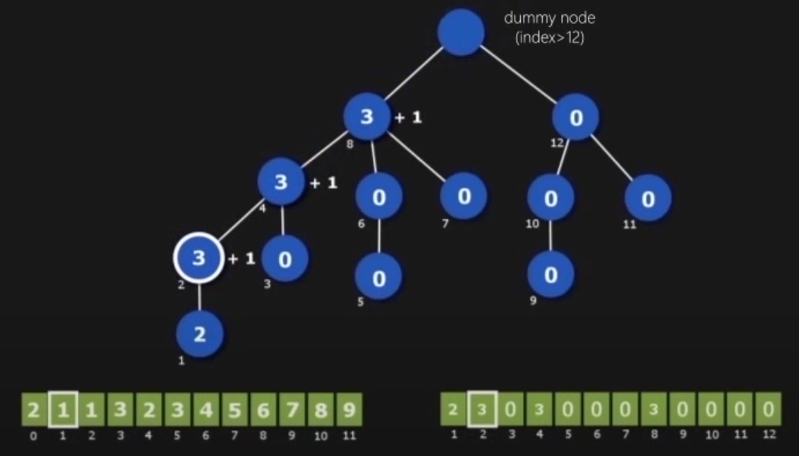
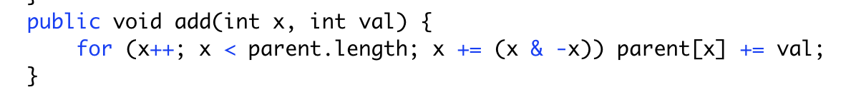

Slide 10
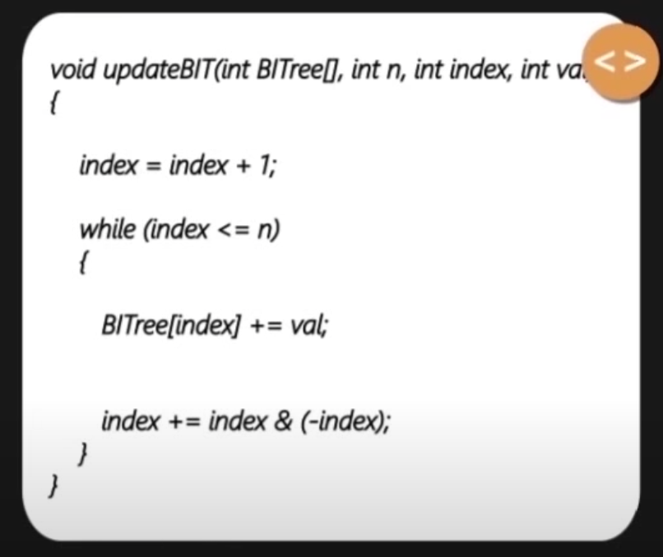
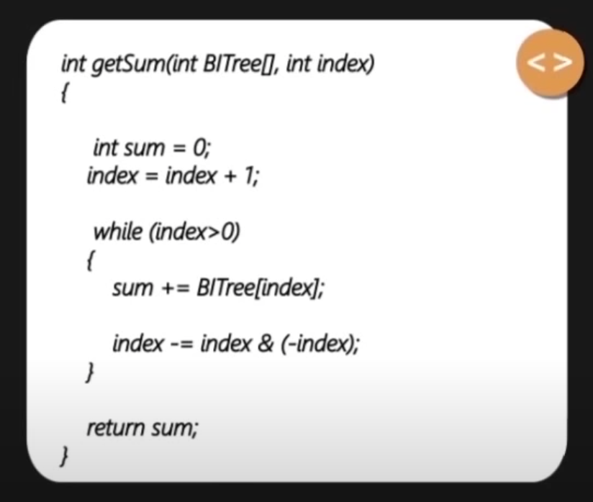
教材模板

Slide 11
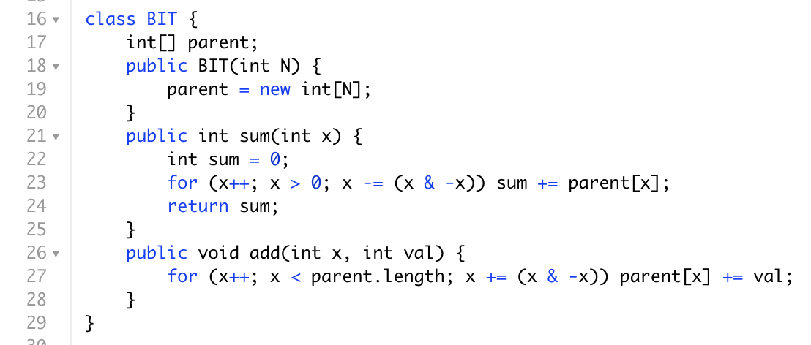
我方模板

Slide 12
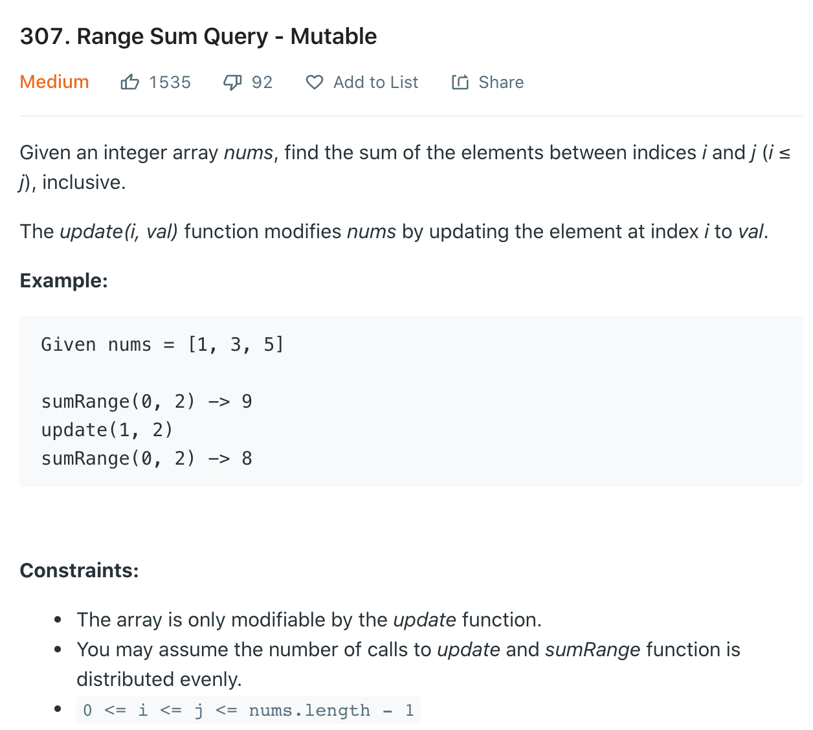
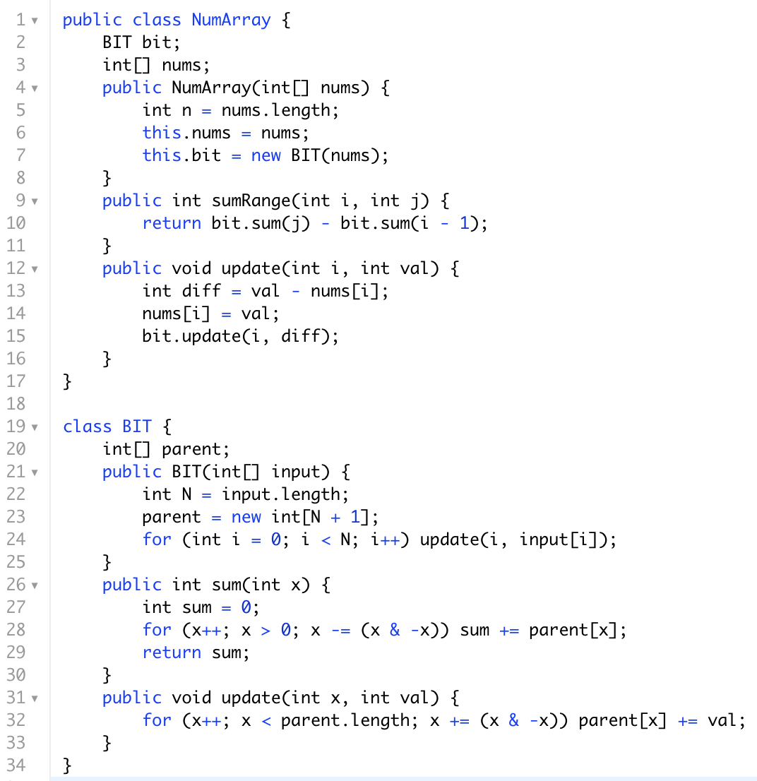

Slide 13
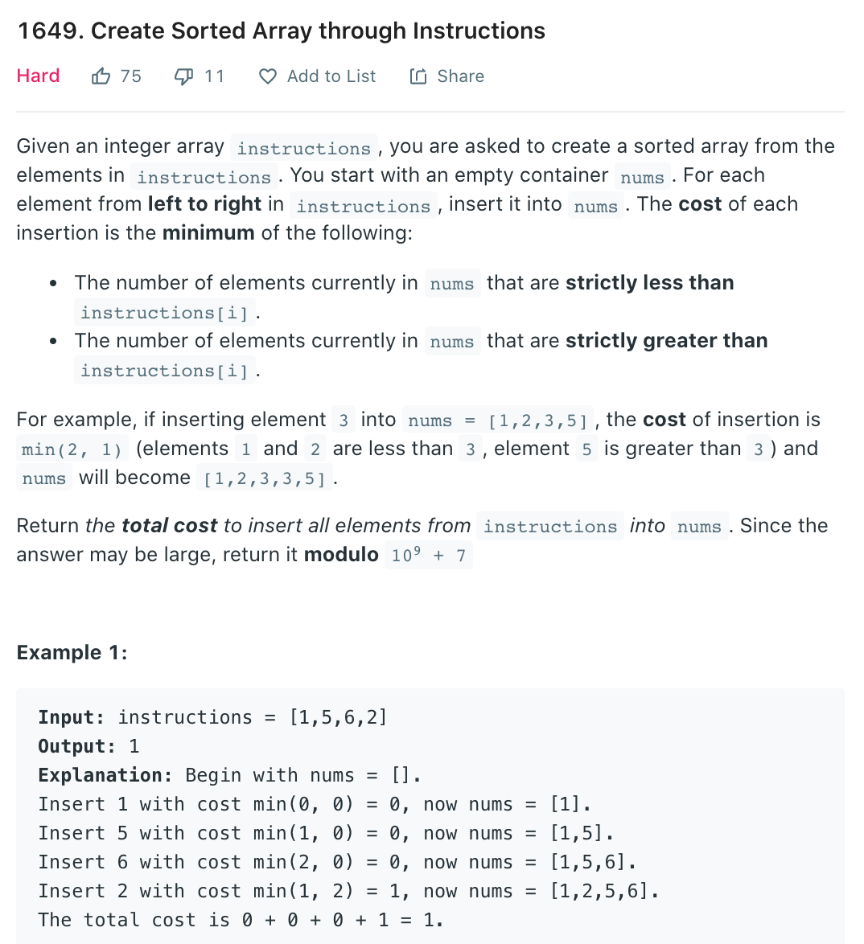
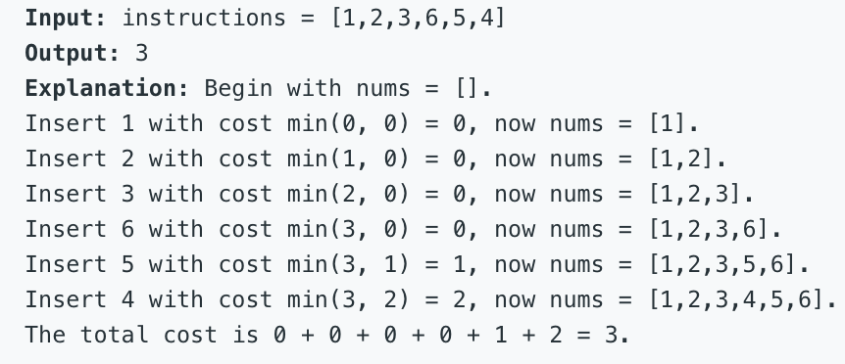
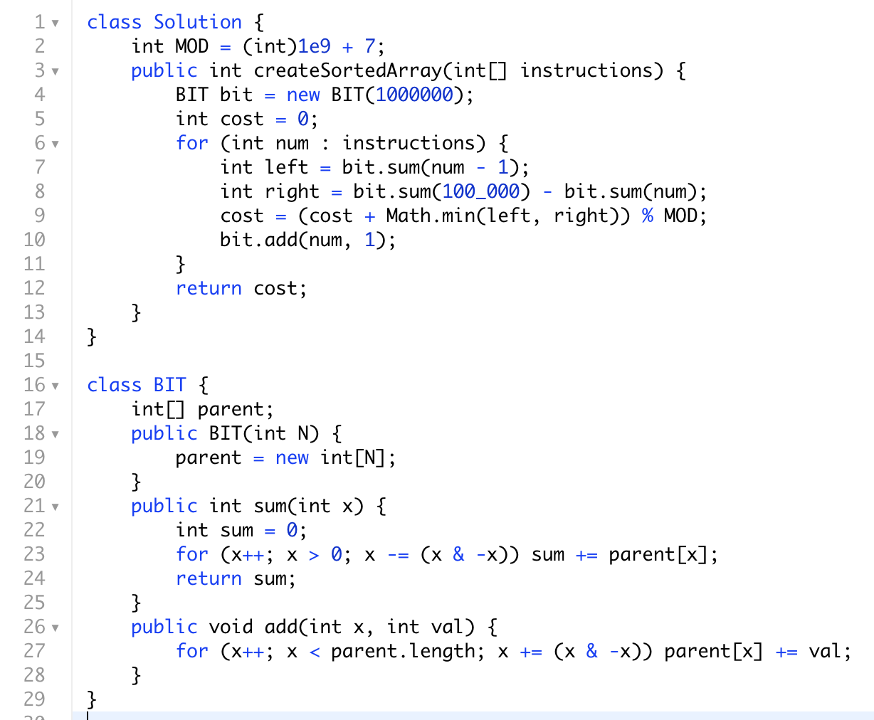

Slide 14
Summary
BIT 一般两个默认method,
sum(i) 取的[0,i] 所有数的和,
update(i, val) index为i的数字增加val的值
时间复杂度sum和update都是O(logn), 建立BIT可以有O(n)优化见附录或者普通nlogn类似heap
rangeSum = sum(j) - sum(i - 1)
not for range max/min, 求区间最大最小值用segment tree

Slide 15
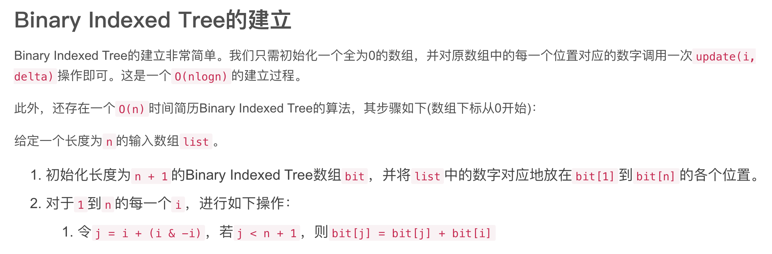
附录：优化建立BIT O(n)算法

